Slide 1
WP4: 5GTANGO SDK Demonstration Presenter: Manuel Peuster (Paderborn University)

Slide 2

SDK demo: Let’s develop a network service!
We are going to …
create a new network service project
browse 5GTANGO network service project and add files
complete the service to be used in validation and deployment demos
use SDK tools to debug and fix the service and its function chain
package service to a single *.tgo package file
on-board package to 5GTANGO V&V and to OSM
Perspective during this demo: Network service developer!

Slide 3
Involved 5GTANGO components
tng-workspace
tng-schema
tng-package
tng-project
tng-sdk-descriptgen
tng-sdk-validate
tng-on board
Project creation
Packaging
&
Uploading
Service & runtime Emulation
Testing & Debugging
Modeling & monitoring
Validation
Image
& SM Preparation
Descriptor writing
5GTANGO Service Development Kit Workflow

Slide 4
Network service to be developed
in
out
VNF1: HAProxy
VNF2: Squid

Slide 6

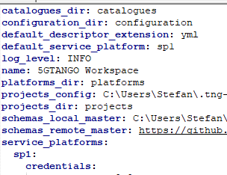
Step 1: Initialize 5GTANGO SDK workspace
tng-workspace
.tng-workspace/
├── catalogues
├── configuration
├── platforms
├── projects
│ └── config.yml
└── workspace.yml
trigger
setup
workspace.yml
tng-workspace
Developer
(that’s us)

Slide 7
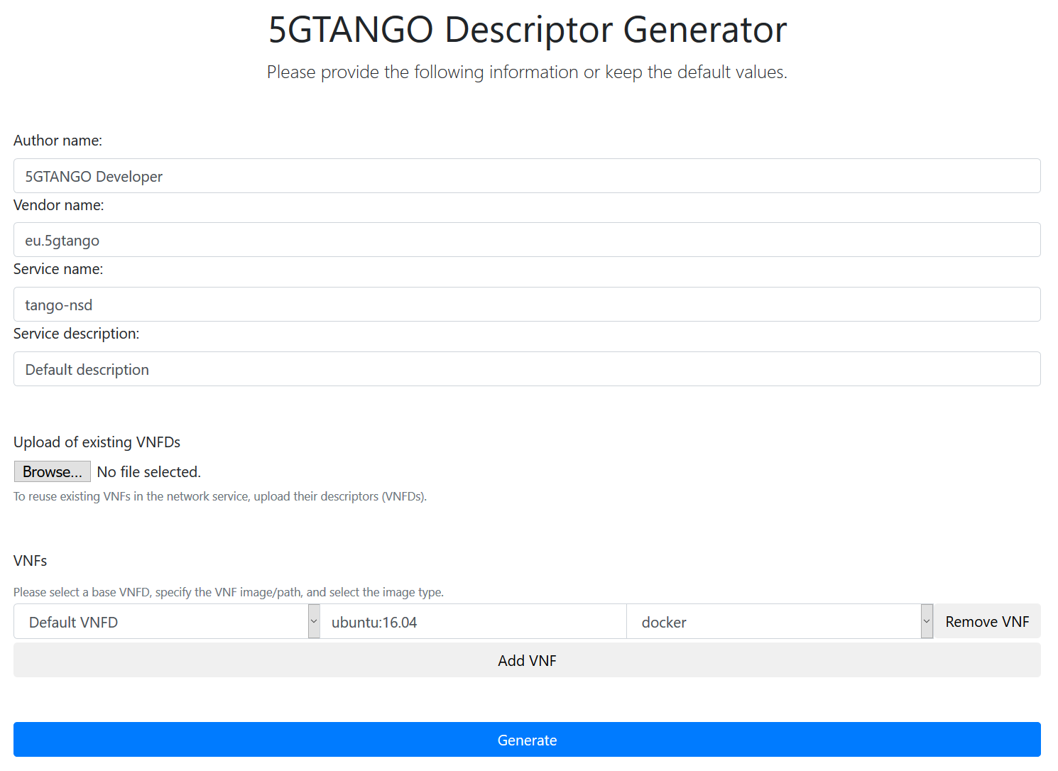
Step 2: Initial descriptor & project generation
project.yml
high-level info
generate
nsd.yml
vnfd.yml
vnfd.yml
vnfd.yml
Developer
(that’s us)

Slide 8
Step 3: Manipulate project
LICENSE.txt
copy
project.yml
trigger
add
tng-project
nsd.yml
vnfd.yml
vnfd.yml
vnfd.yml
Developer
(that’s us)

Slide 9
Step 4: Switch to prepared project
project.yml
edit
nsd.yml
vnfd.yml
vnfd.yml
Developer
(that’s us)
vnfd.yml
git pull

Slide 10
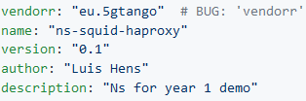
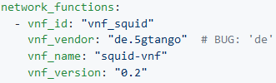
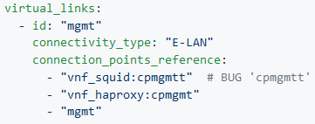
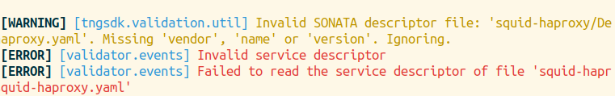
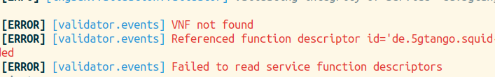
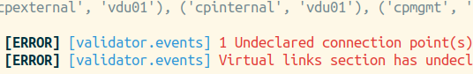
Step 5: Find bugs using tng-validate
Bug 1: Syntax error (typo)
Bug 2: Integrity error
(incorrect reference)
Bug 3: Topology error
(incorrect connection point)

Slide 11
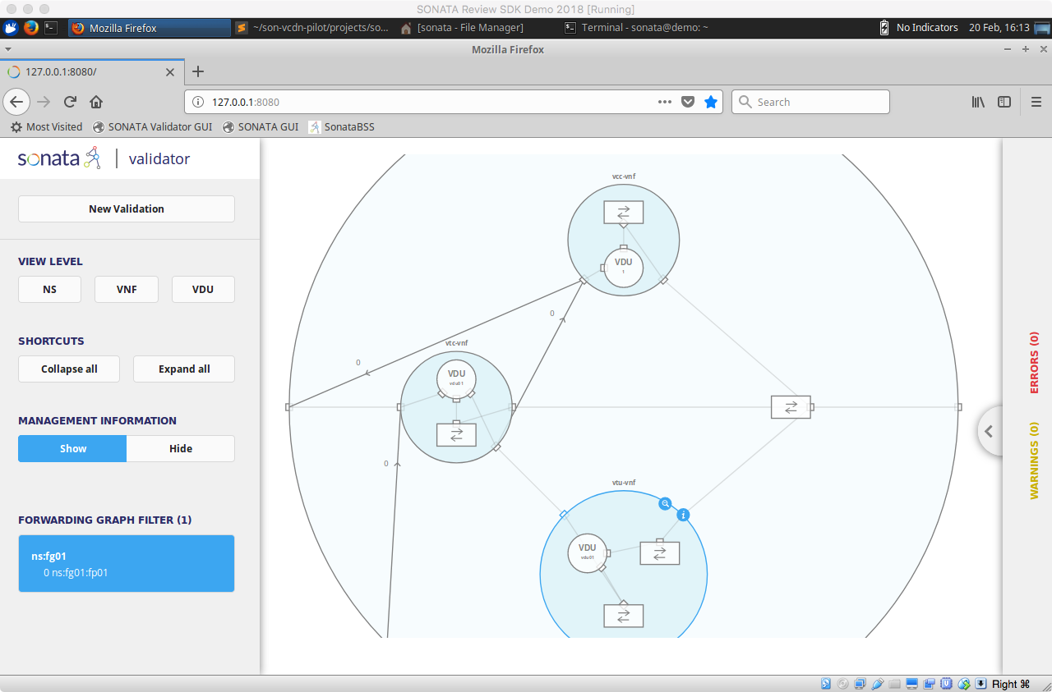
Step 6: Analyze the validated service in GUI
analyze/check
Developer
(that’s us)

Slide 12
Step 7: Package validated service
project.yml
nsd.yml
vnfd.yml
ETSI VNF Pkg. Format
(ETSI SOL004) compatible
vnfd.yml
vnfd.yml
read
trigger
write
tng-package
Developer
(that’s us)
5GTANGO package

Slide 13


Step 8: On-board to 5GTANGO and OSM
V&V
1.
on-board
2.
Developer
(that’s us)
5GTANGO package

Slide 14
Ready for validation & deployment!

Slide 15
5GTANGO SDK: Key takeaways
Simple, graphical generation of service descriptors and projects
User friendly management of network service projects
Easy-to-use validation tool for fast identification of a vide variety of bugs and errors prior to service deployment
Powerful, fully automated packaging procedure generating standard-compliant packages
Generic, extensible 5GTANGO package format compatible with OSM
Fully integrated service development kit for NFV!
Speeding up the service development cycle!

Slide 16
Q&A

Slide 17
Demo Screenshots

Slide 18

Starting point: Xubuntu 18.04 VM

Slide 19
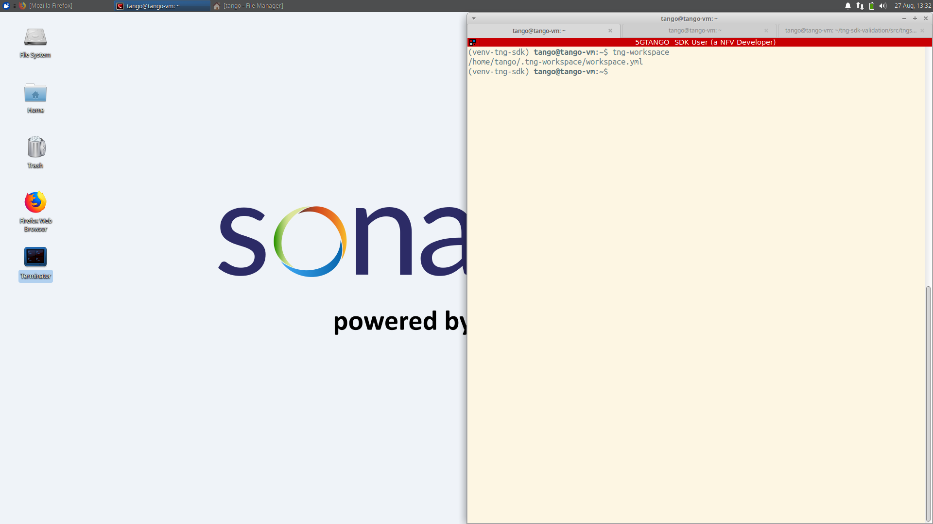
Initialize workspace

Slide 20
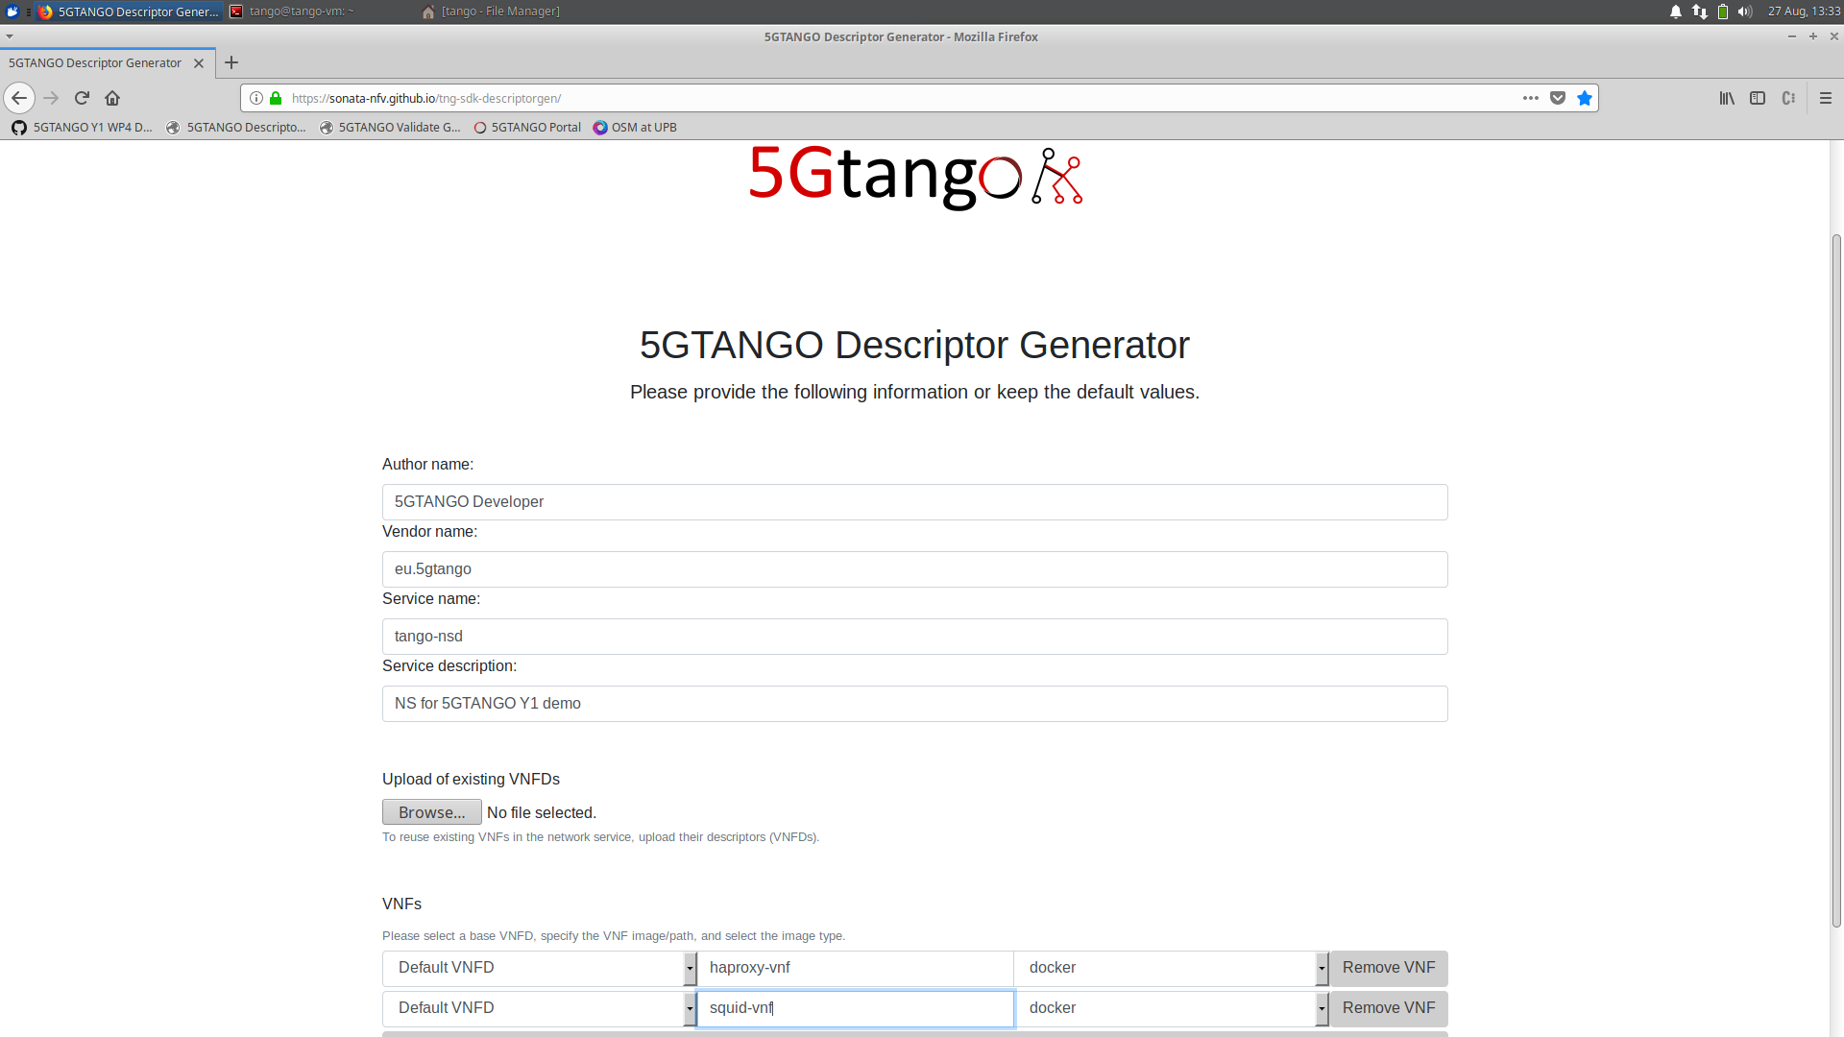
Descriptor generation: Enter high-level info

Slide 21
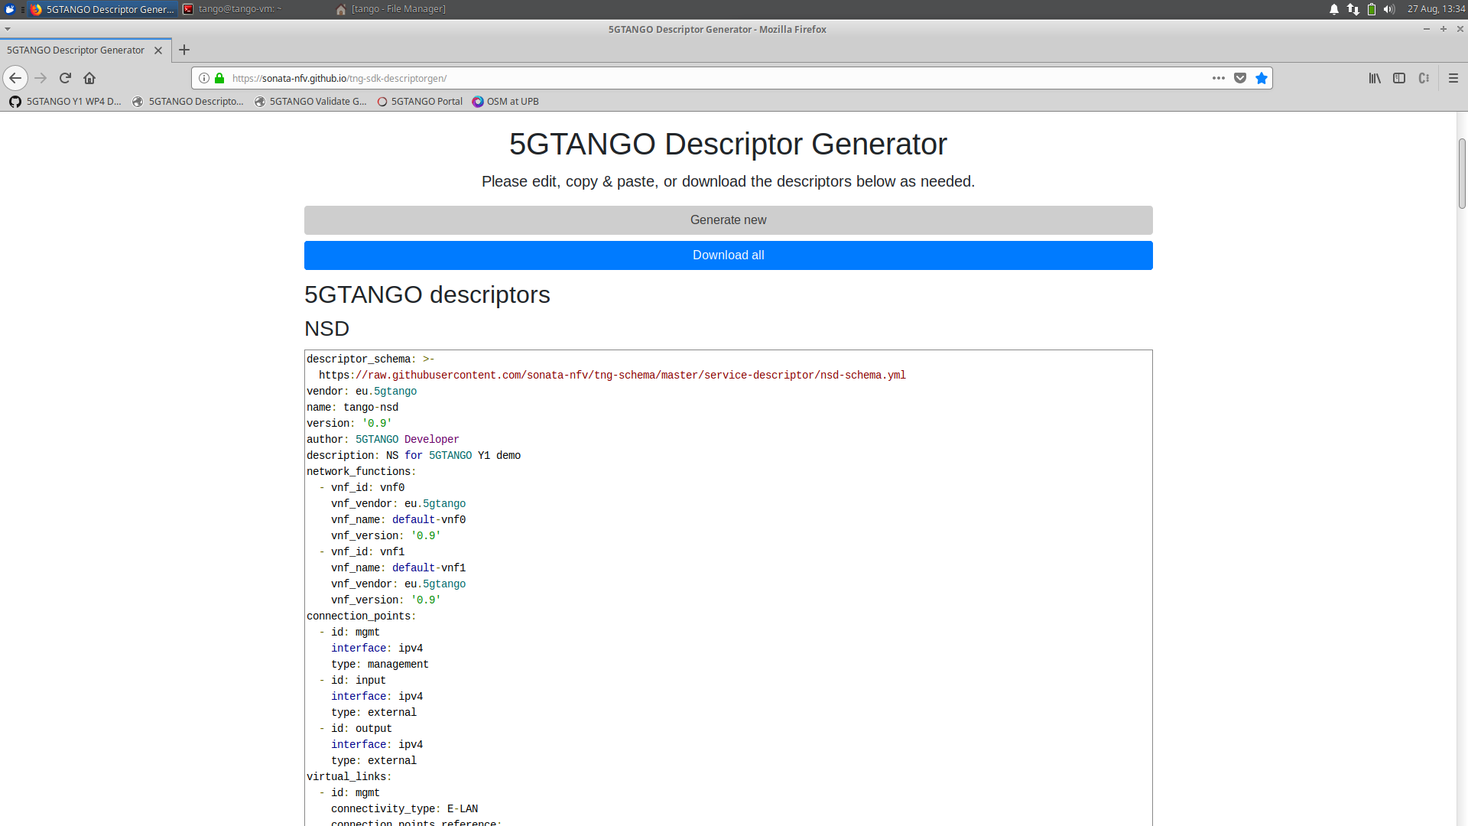
Descriptor generation: Generated descriptors

Slide 22
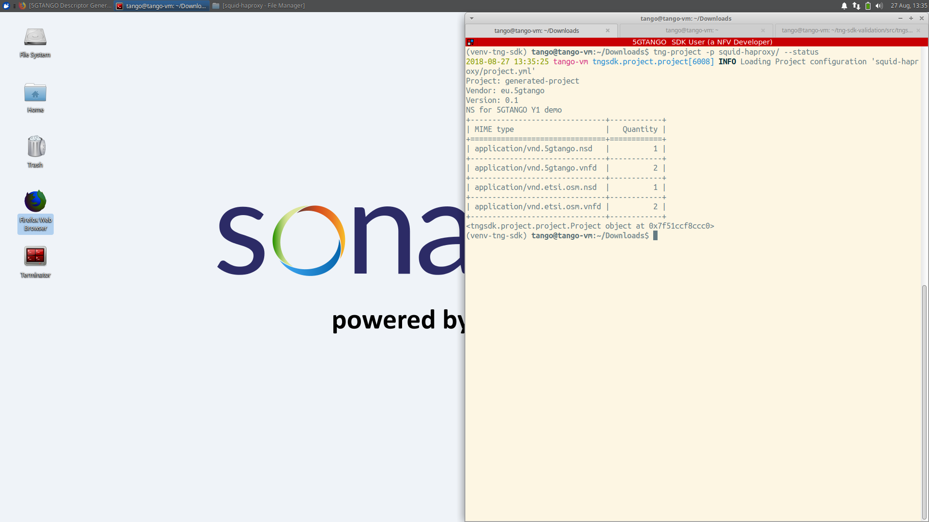
Status of generated project

Slide 23
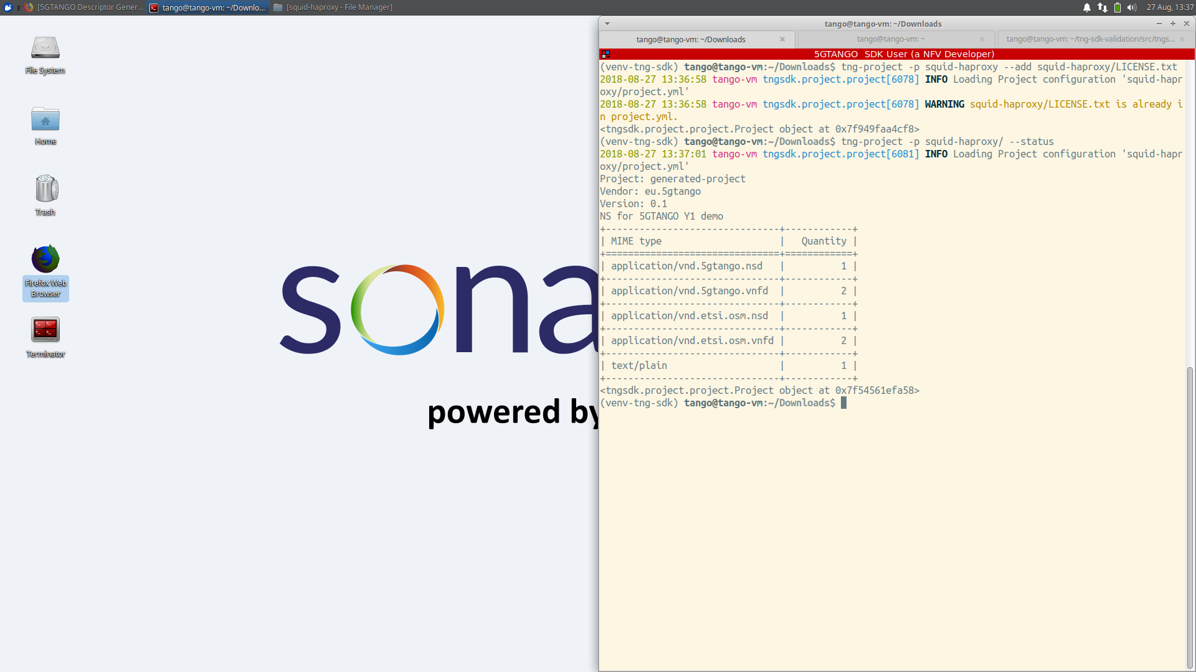
Add license file to project

Slide 24
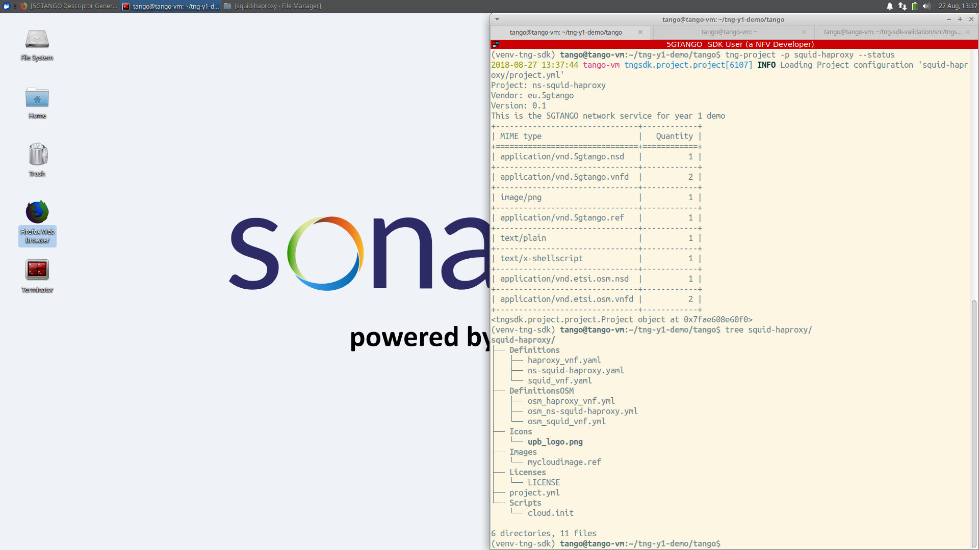
Switch to prepared project

Slide 25
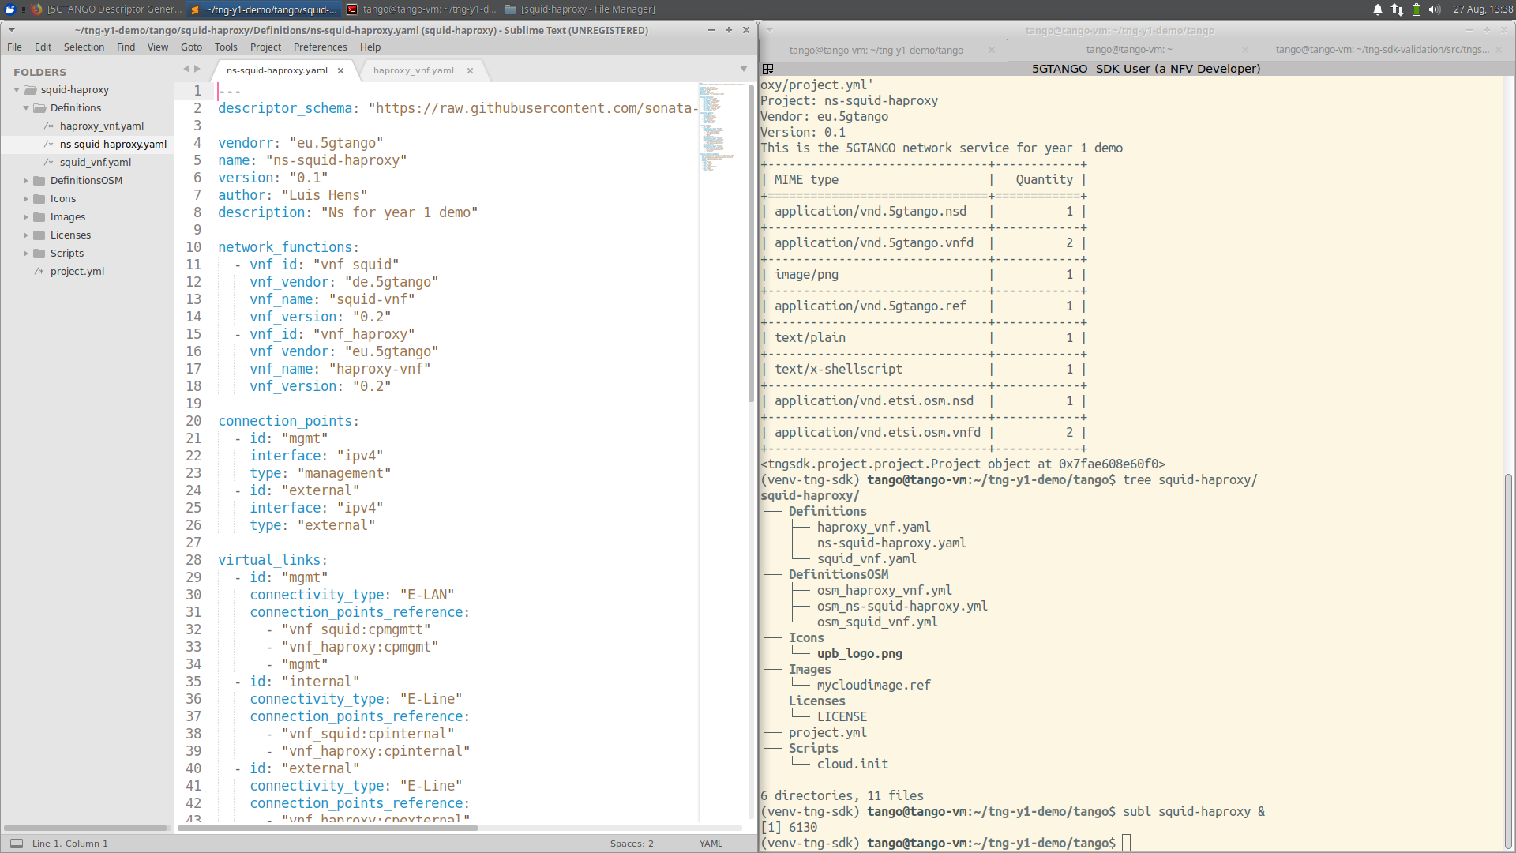
Network service descriptor

Slide 26
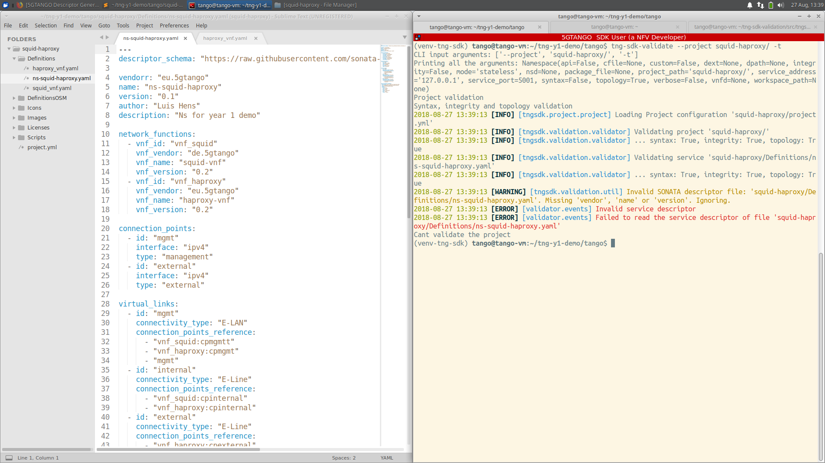
Descriptor validation: Syntax error (vendorr)

Slide 27
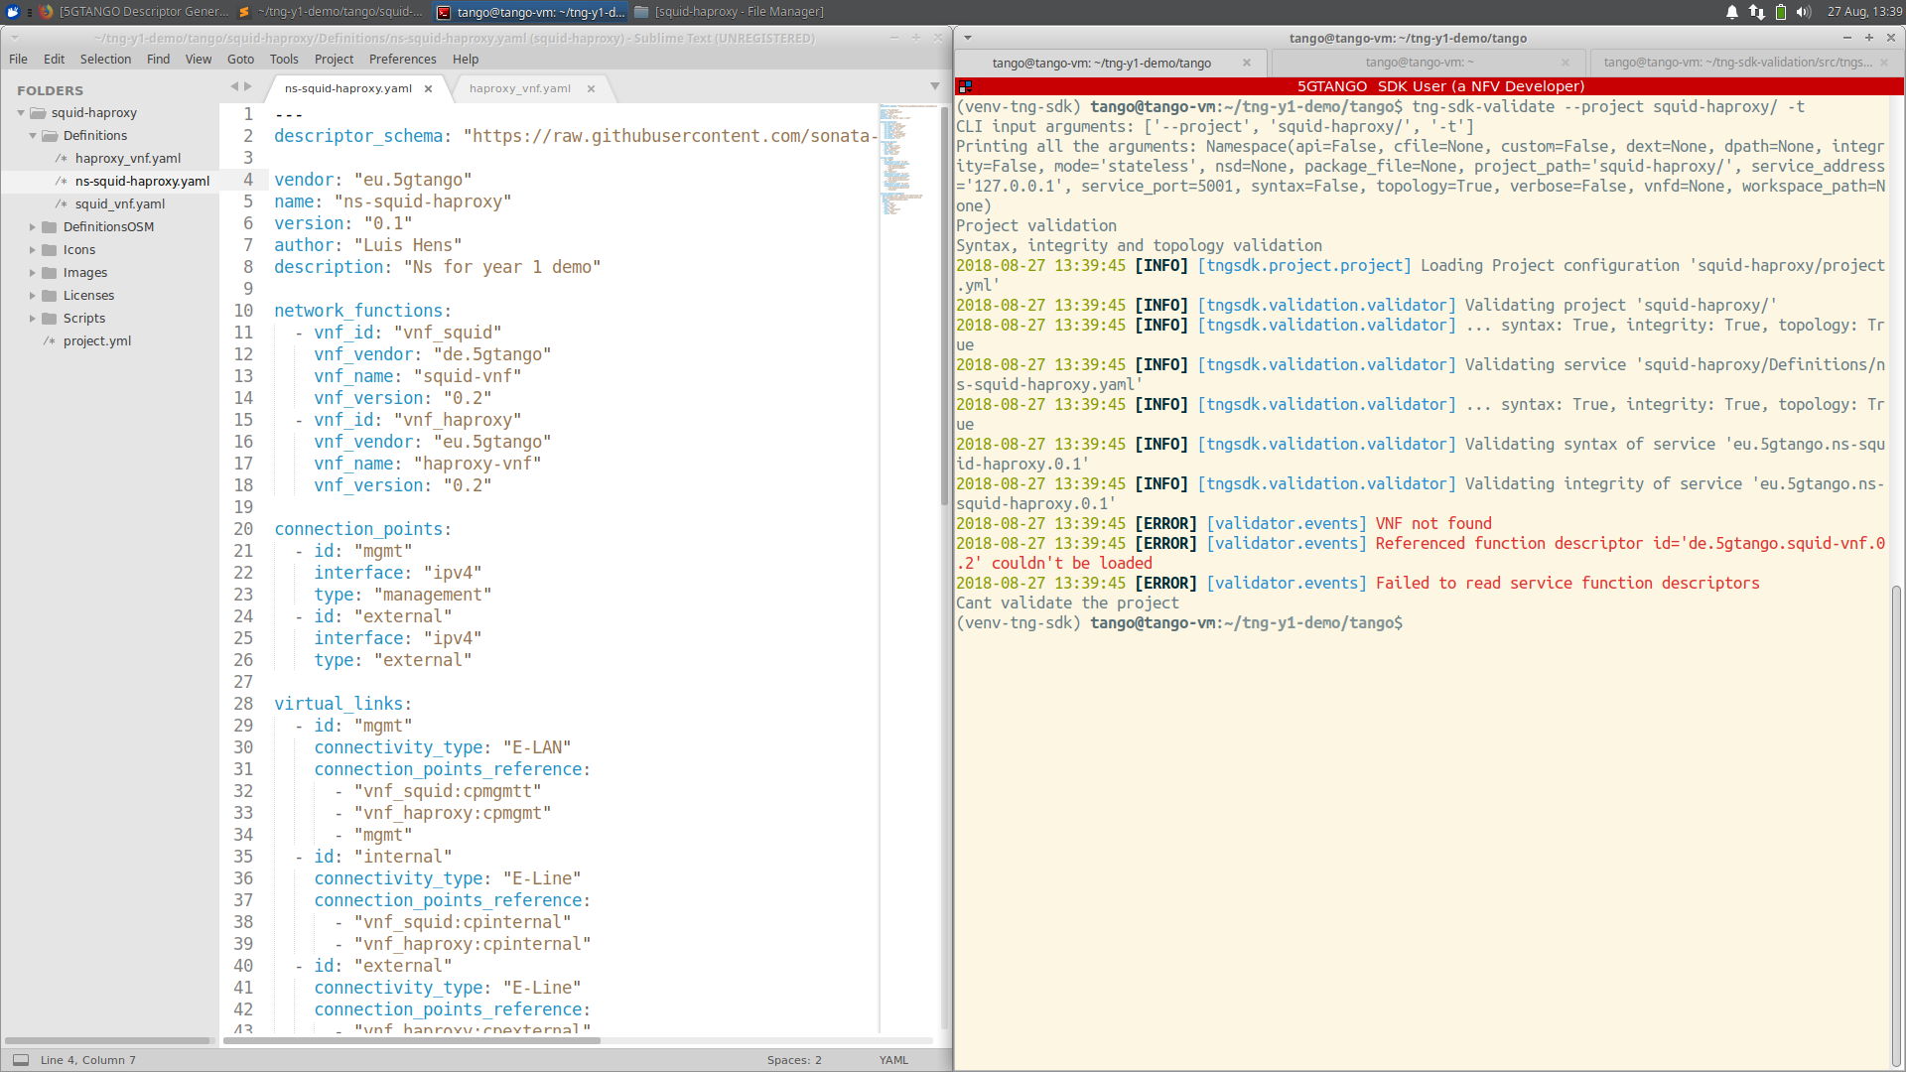
Descriptor validation: Integrity error (de.5gtango)

Slide 28
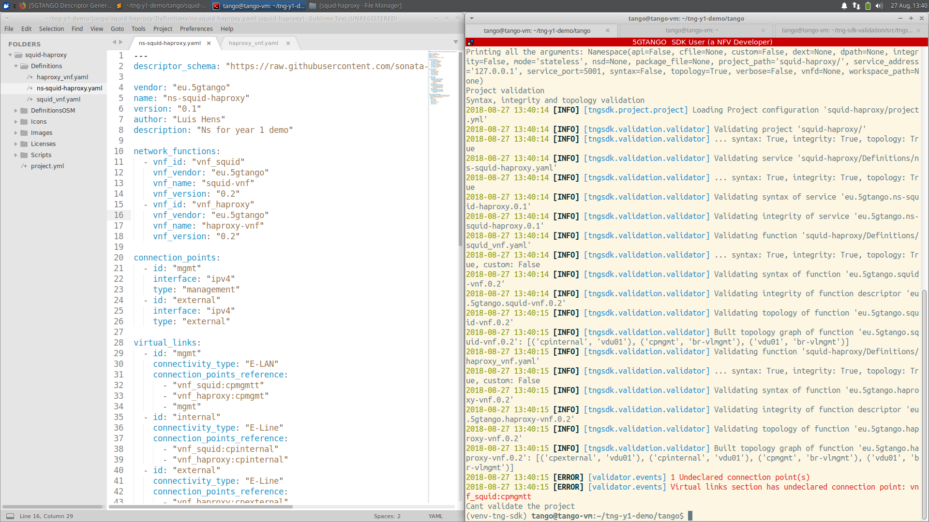
Descriptor validation: Topology error (conn. point)

Slide 29
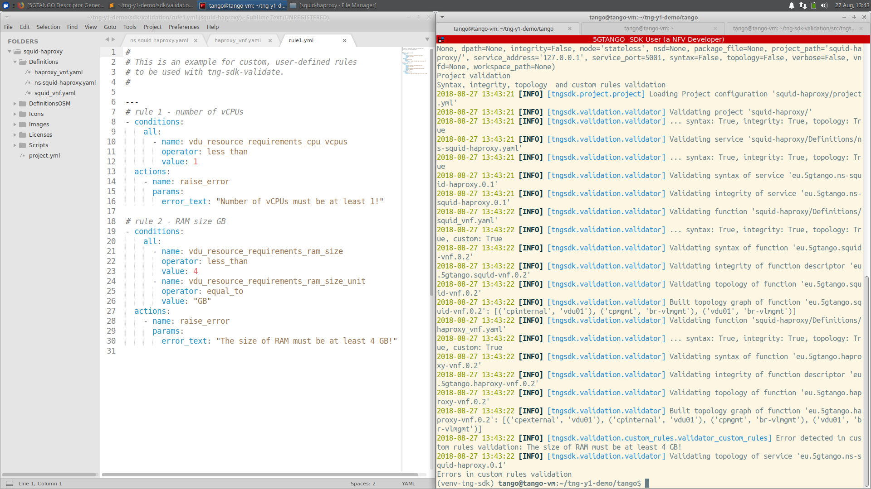
Descriptor validation: Custom rule

Slide 30
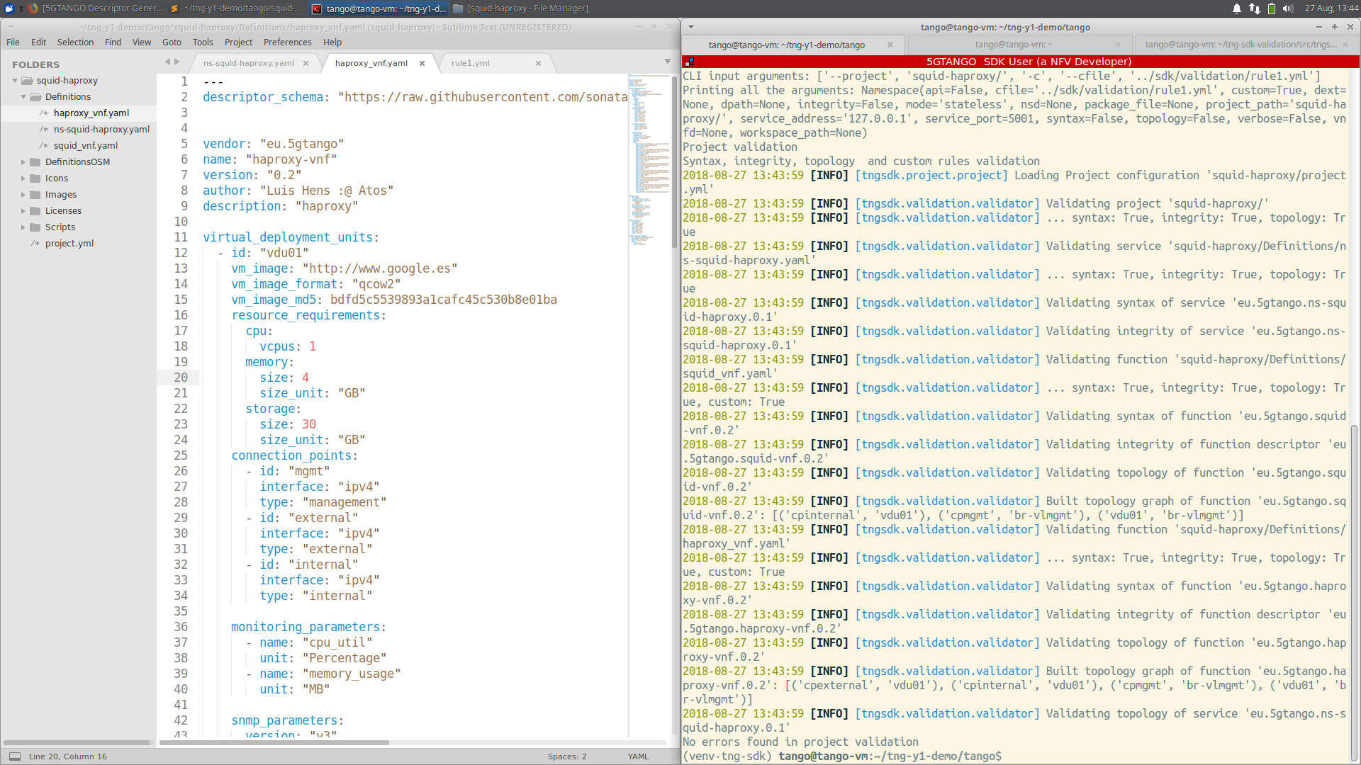
Descriptor validation: No more errors

Slide 31
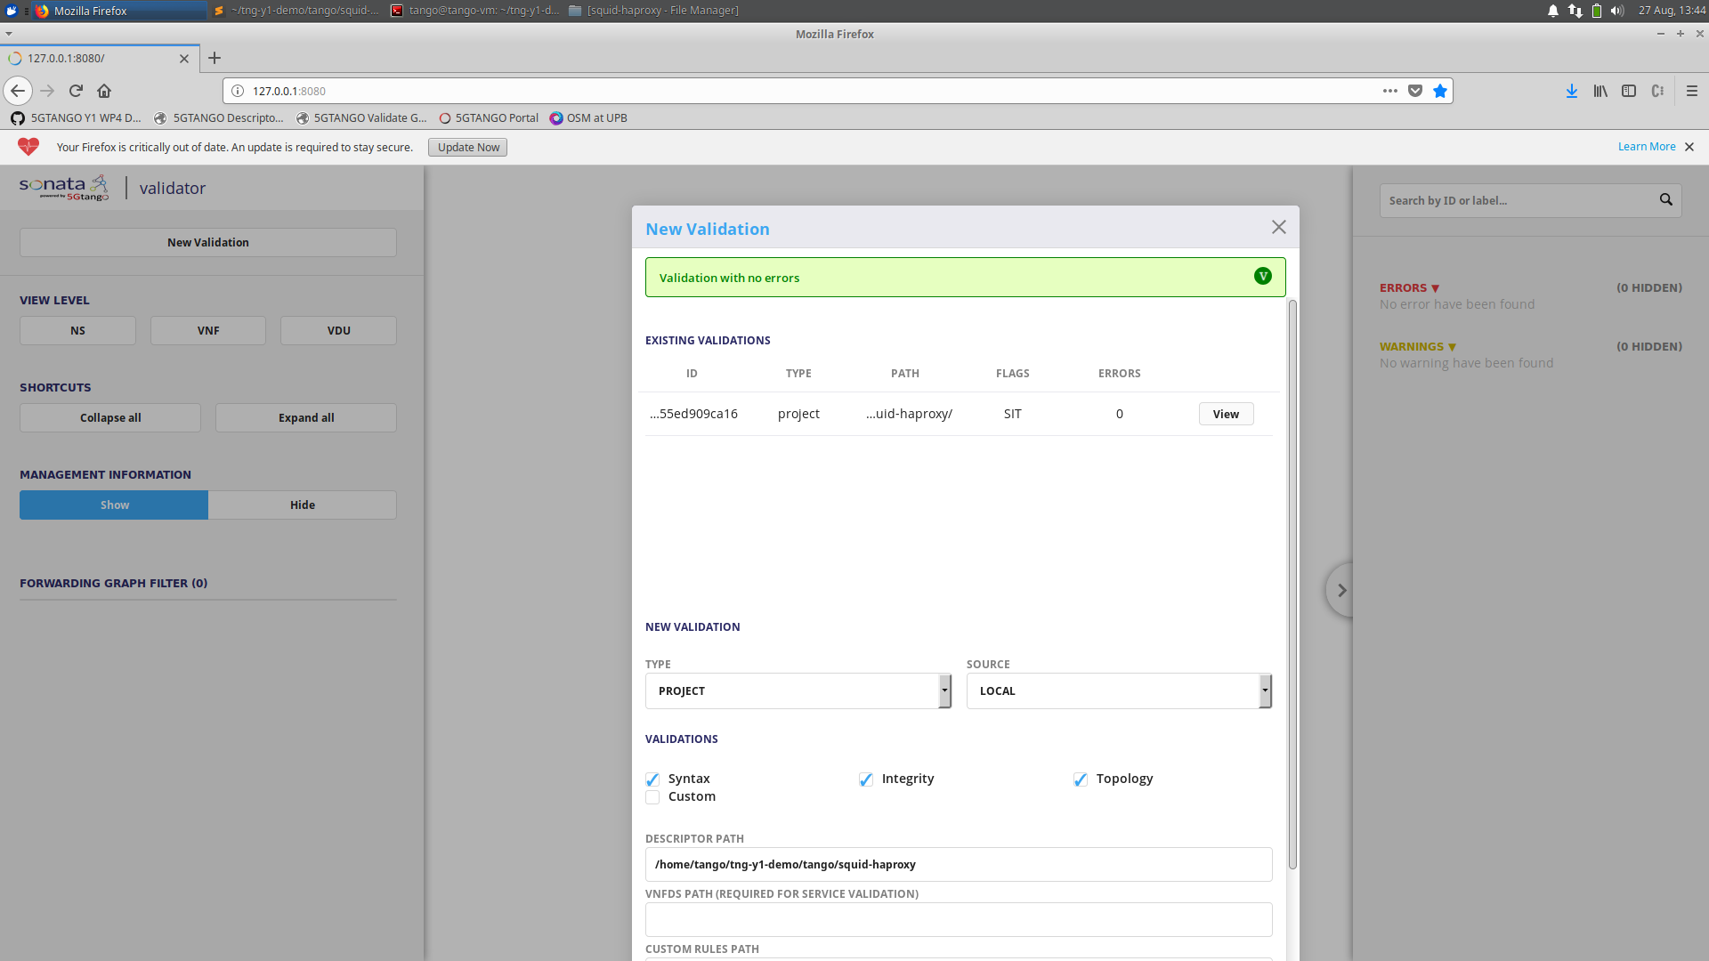
Validator GUI: New validation

Slide 32
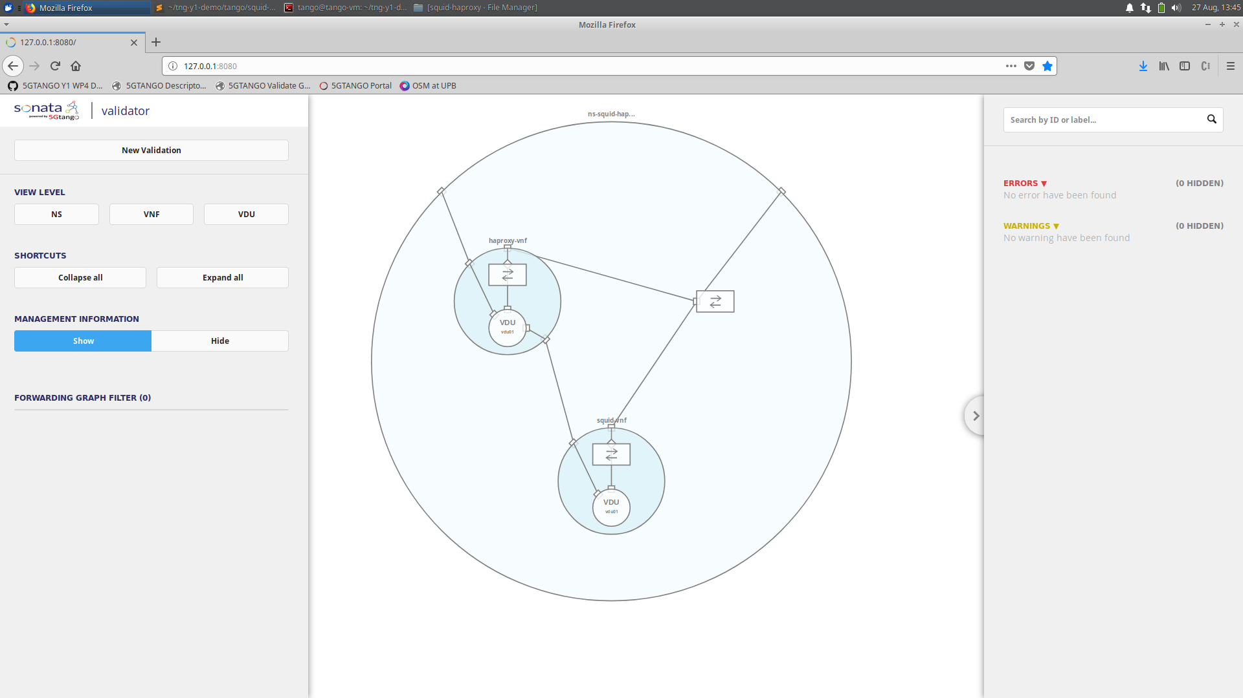
Validator GUI: Service topology overview

Slide 33
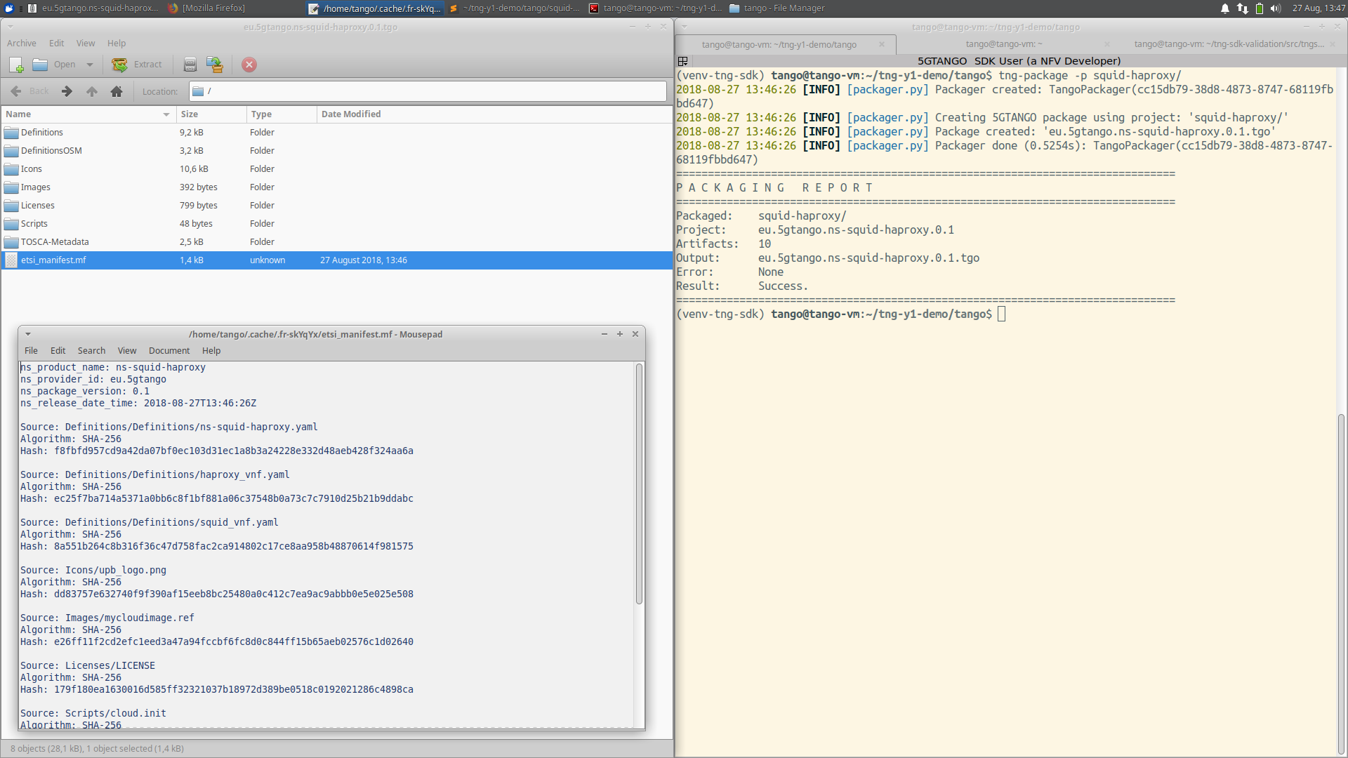
Package validated project

Slide 34
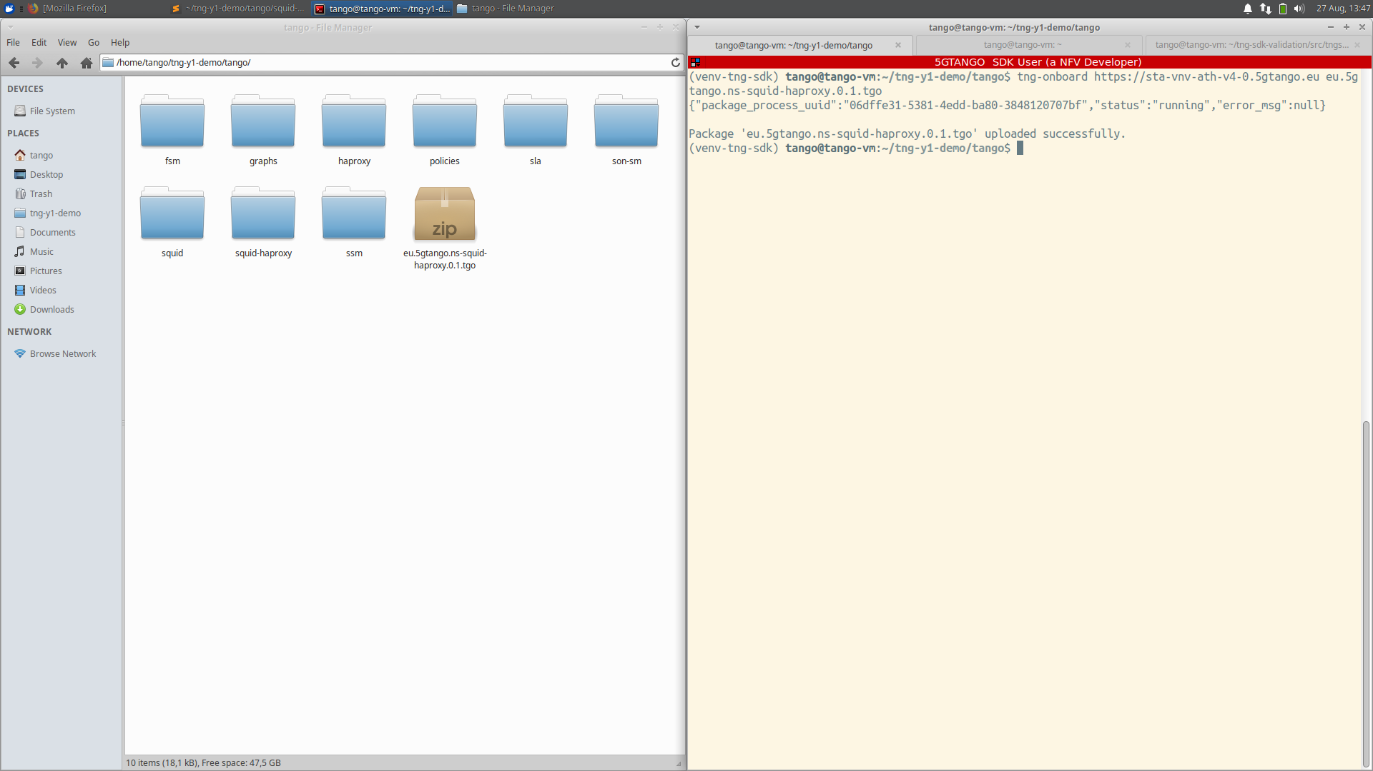
On-board package to 5GTANGO V&V

Slide 35
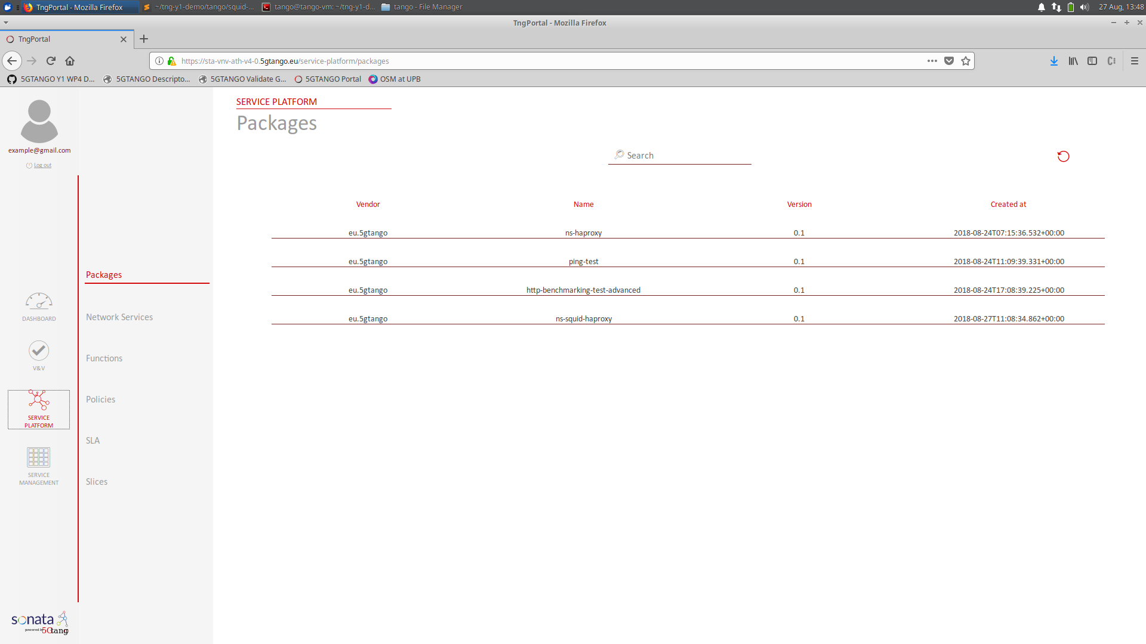
On-boarded to 5GTANGO successfully

Slide 36
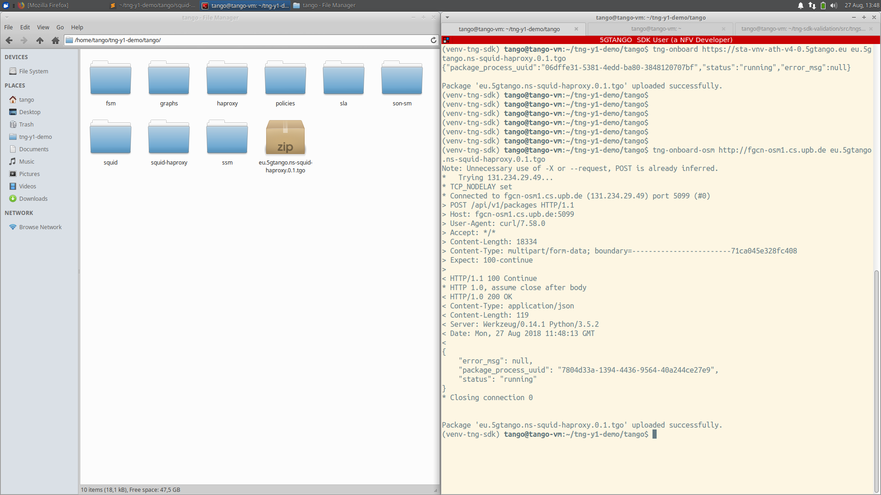
On-board package to OSM

Slide 37
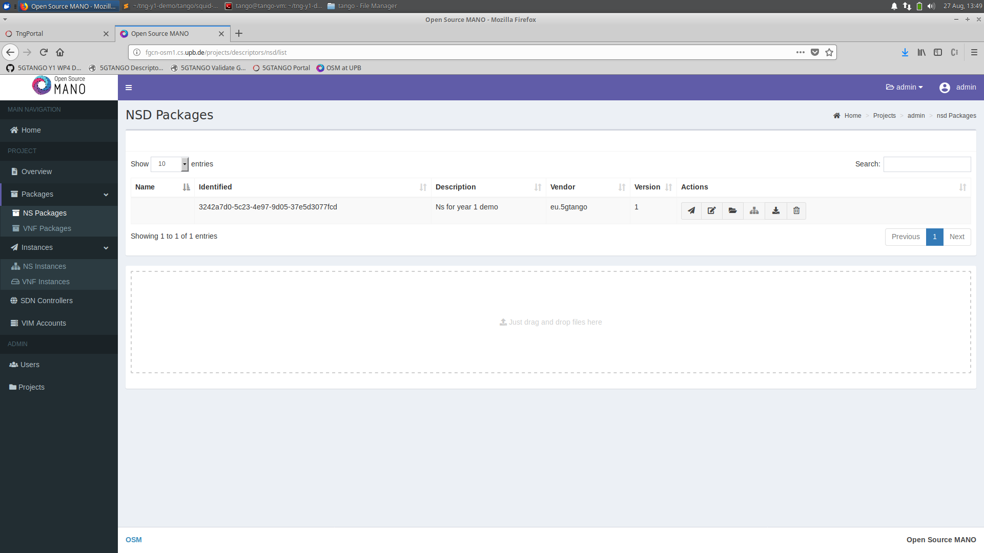
On-boarded to OSM successfully

Slide 38


Thanks!
5G DEVELOPMENT AND VALIDATION PLATFORM FOR GLOBAL INDUSTRY-SPECIFIC NETWORK SERVICES AND APPS

